Slide 1
TC Location FM TVT
Takashi Oshiro

Slide 2
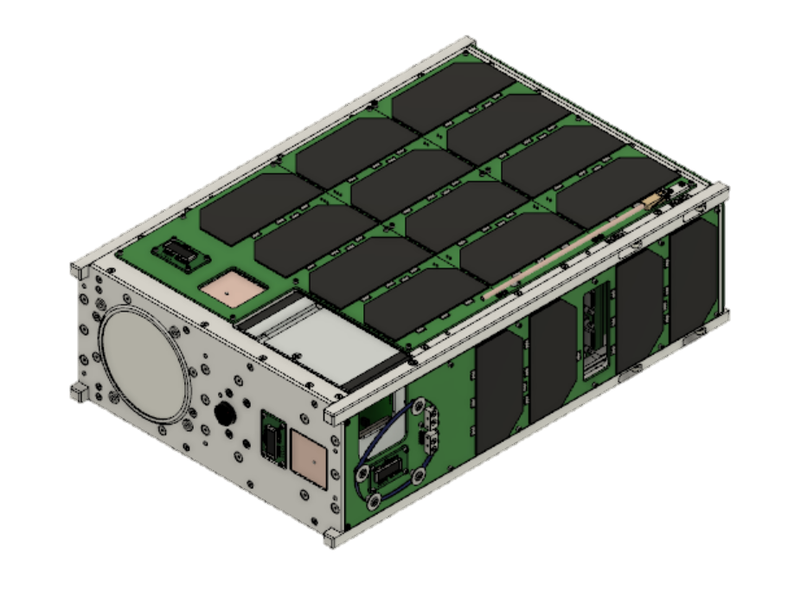
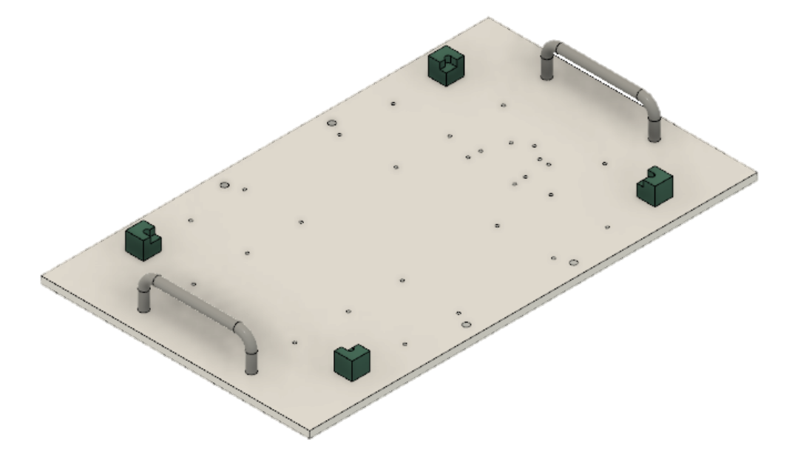
Configuration
X
Z
KITSUNE
Heater
TVT Stand
Height adjustment
Y

Slide 3
Configuration
X
Z
Y

Slide 4
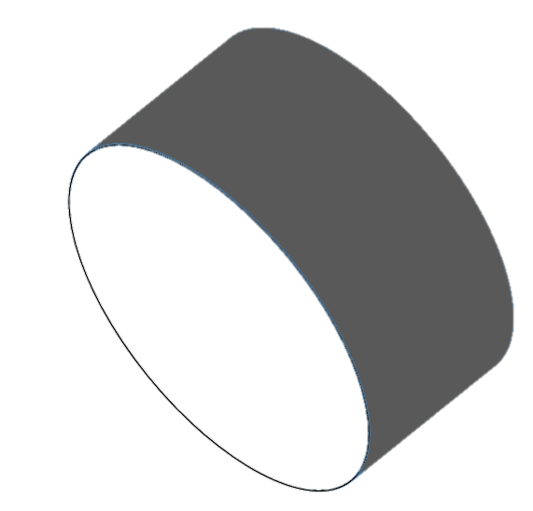
Configuration
X
Z
Y
SPACE chamber
Collimator

Slide 5
Thermocouple location
Part | Type | Num
Stand | T | 1
IR heater | T | 11
External panel | T | 10
Antenna | T | 0
Camera sensor ＆ board | T | 3
Camera outer case | T | 4
Camera protector | T | 2
2U MAIN BUS | T | 7
SPATIUM2 | T | 3
MAI401 | T | 0
Aluminum plate | T | 4
Frame | T | 1
SUM | - | 46
Thermistor and temperature sensor
Part | Type | Num
Camera internal case (near camera heater) | Thermistor | 1
Camera lens | Thermistor | 2
Battery inside the insulator | Sensor | 2
CPLD | Sensor | 2
Panel (without -Z) | Sensor | 5

Slide 6
Thermocouple location [STAND＆-X heater]
-X heater back
T21
X
Z
T29
Front stand
Y
T20
-X heater front

Slide 7
Thermocouple location [Other heater]
T25
-Y heater back
T24
-Y heater front
T26
+Z heater
X
Z
Y
Additional 4 points
・+Y heater front
・+Y heater back
・+X heater front
・+X heater back
T22
T23
T18
T28
-Z heater -Y side
T27
-Z heater +Yside
T19

Slide 8
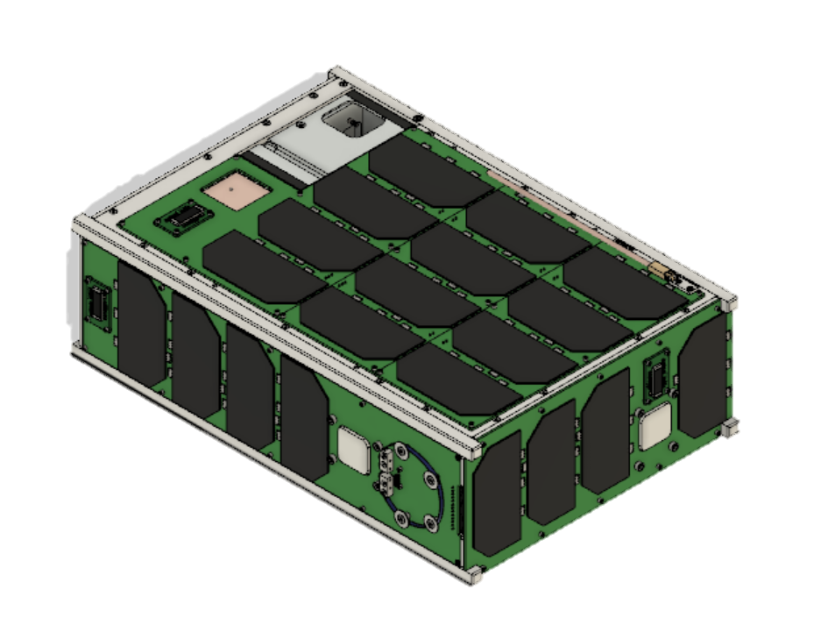
Thermocouple location [External panel]
T6
T7
T8
-X panel back
T14
-Y+X middle panel
Y
X
+X panel back
-X panel front
Z
Z
X
Y
+X panel front
T5
T10
-Y panel front
T9
+Y panel
T13
-Z panel (under MLI)
T11
-Y panel back
T12
+Z panel

Slide 9
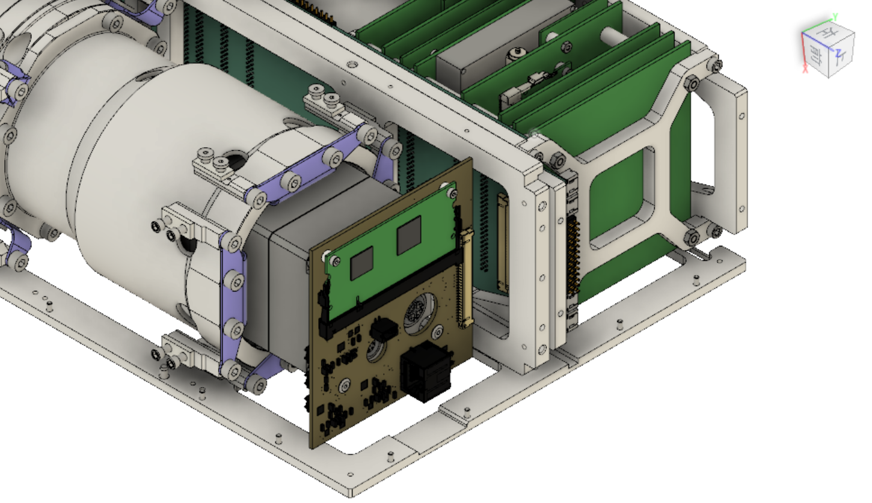
Thermocouple location [Camera board]
Y
Z
X
T40
Camera board RPI

Slide 10
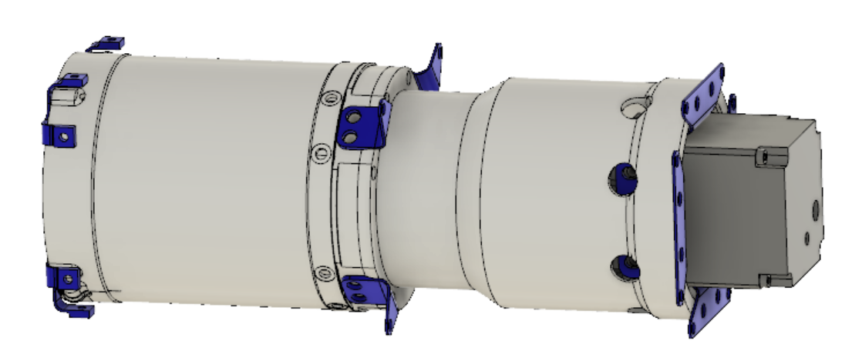
Thermocouple location [Camera outer case (HSK proposed)]
Y
Cover outer1 -X
Z
Cover outer3 -X
T44
T46
X
Camera sensor
+X
T43
T45
T41
Cover outer1 +X
MLI
T42
Cover outer3 +X
Camera sensor outside of MLI(+X)

Slide 11
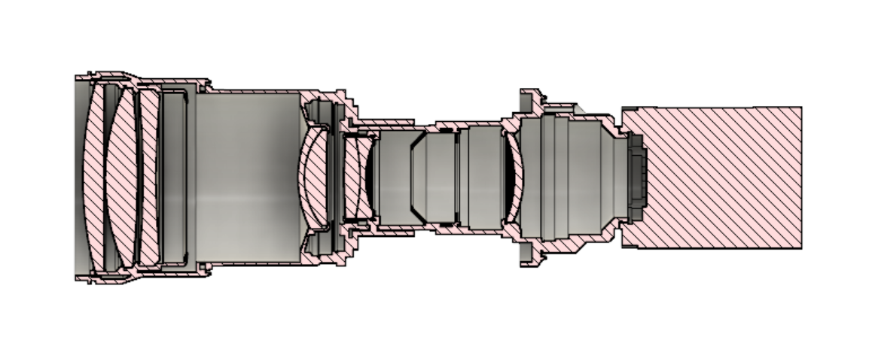
Thermocouple location [Camera lens]
Y
Thermistor(T1)
Thermistor(T2)
Thermistor(T3)
Z
Camera protector
(+X,-X)
T47
T48

Slide 12
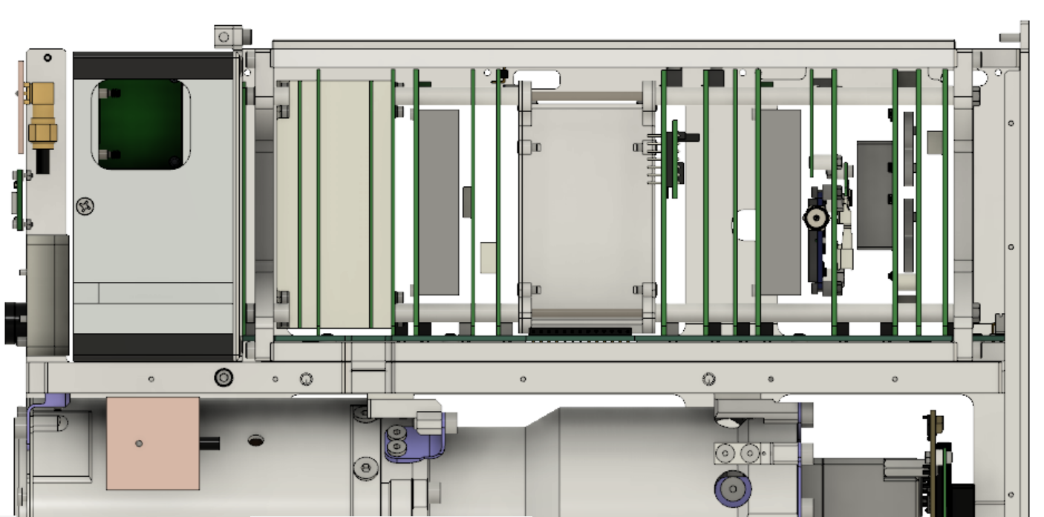
Thermocouple location [MAIN BUS]
Y
T31
2UMB COM
T32
T33
Z
2UMB OBC/EPS
Battery box inside
T30
C-band
T34
Battery box outside
T36
T35
Backplane (Z side)
Backplane (-Z side)

Slide 13
Thermocouple location [SPATIUM2]
Y
T37
T38
SPATIUM COM
Z
SPATIUM OBC/EPS
T39
CSAC

Slide 14
Thermocouple location [Frame]
X
T15
-Y+X middle frame
Z
Y

Slide 15
Thermocouple location [Aluminum plate]
T1
+X aluminum plate
T2
+Y aluminum plate
T3
-X aluminum plate
T4
-Y aluminum plate

